Slide 1

Perth crime analysys
Richard allen
Conor mccabe

Slide 2
Approach:
- Neil Armstrong

Slide 3
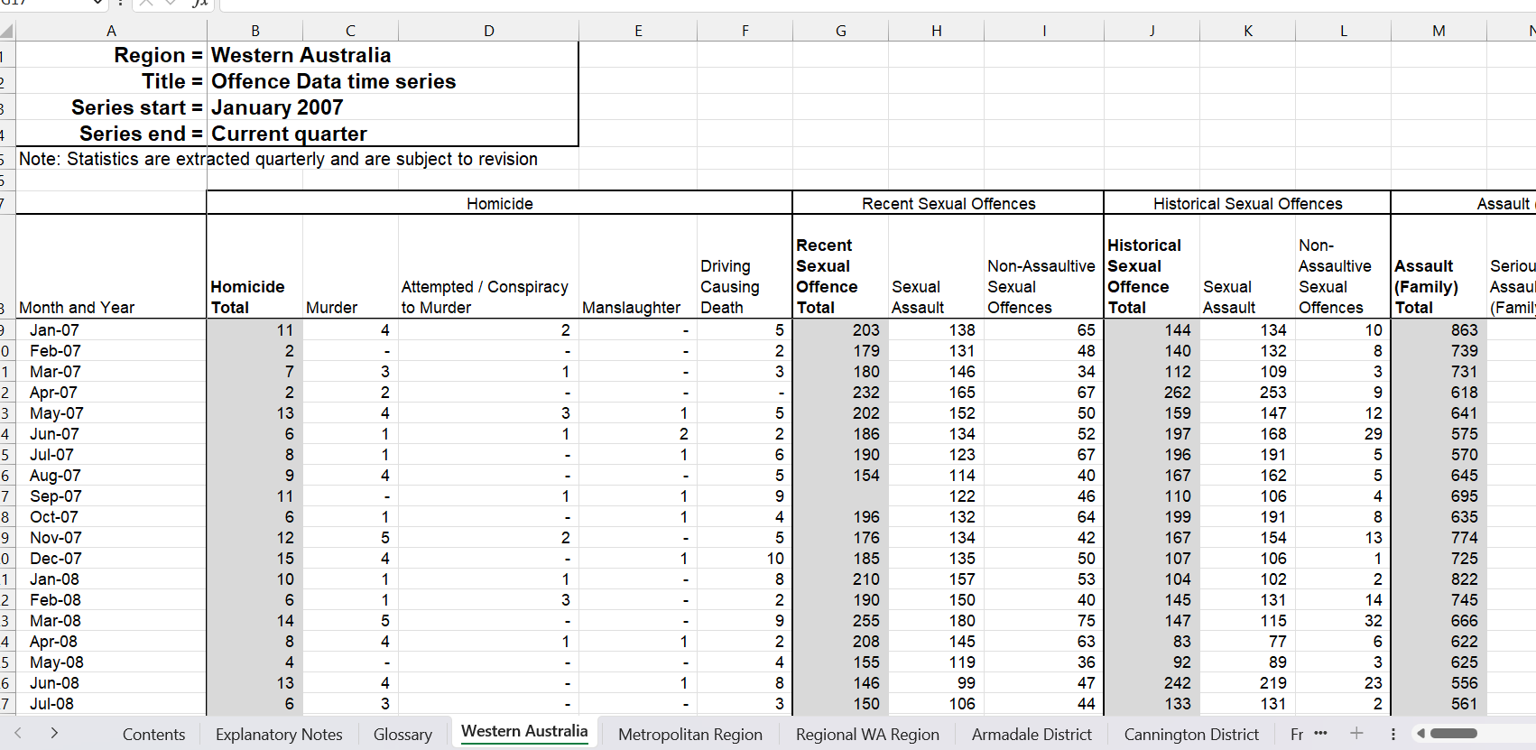
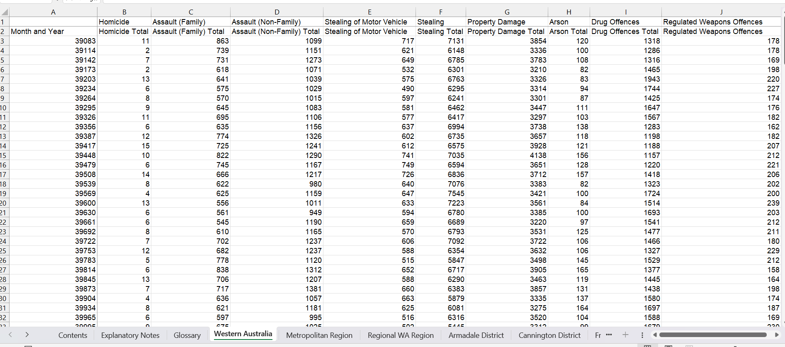
Raw data

Slide 4
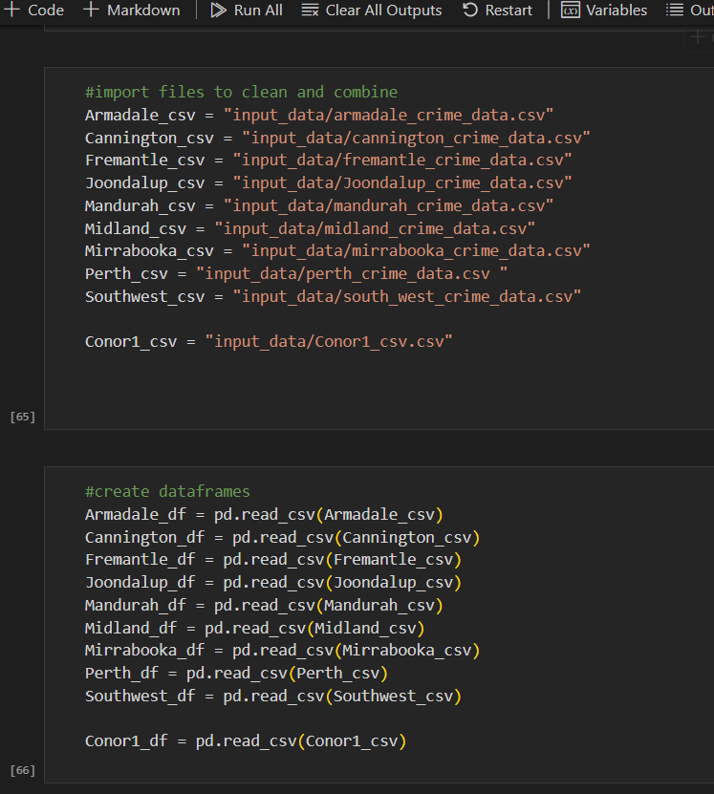
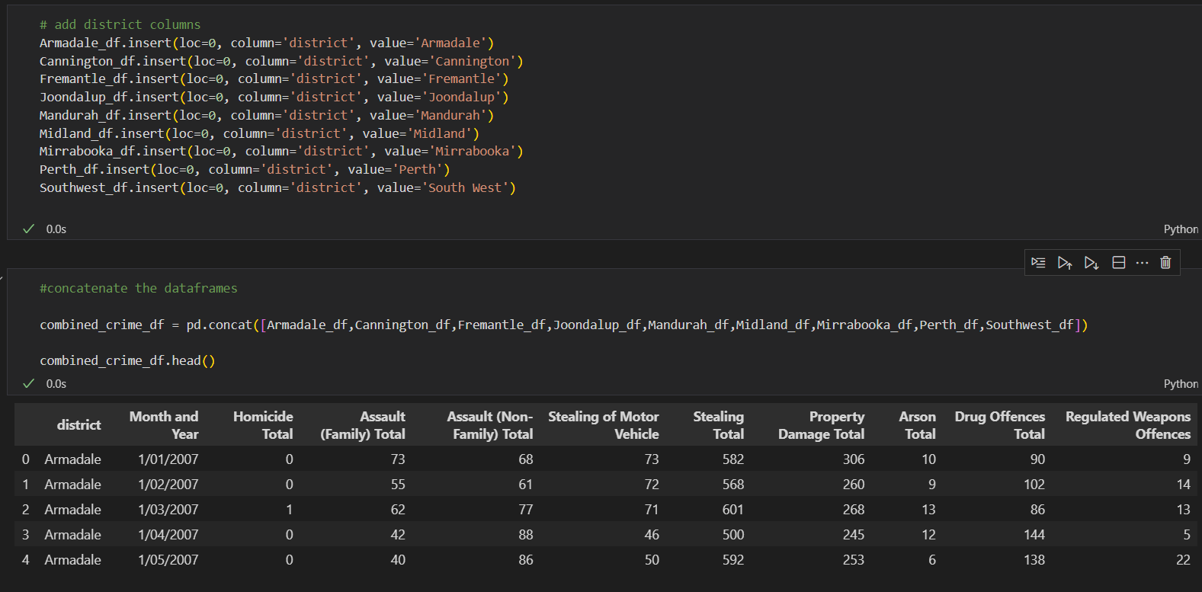
Cleaning and organising

Slide 5
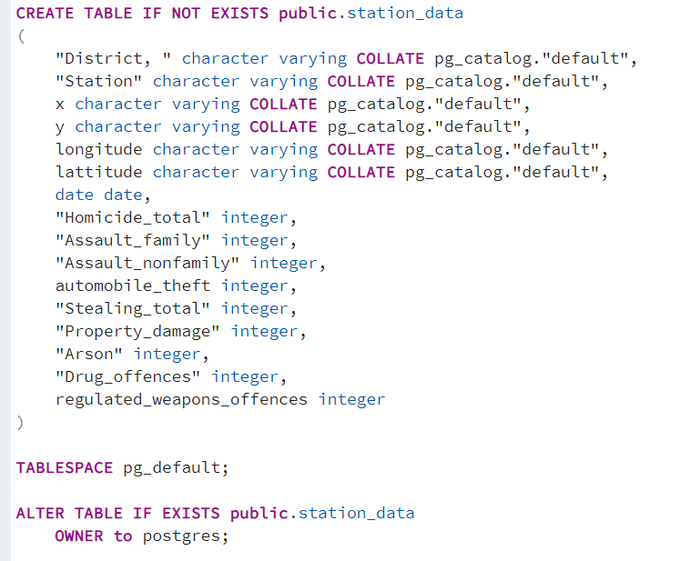
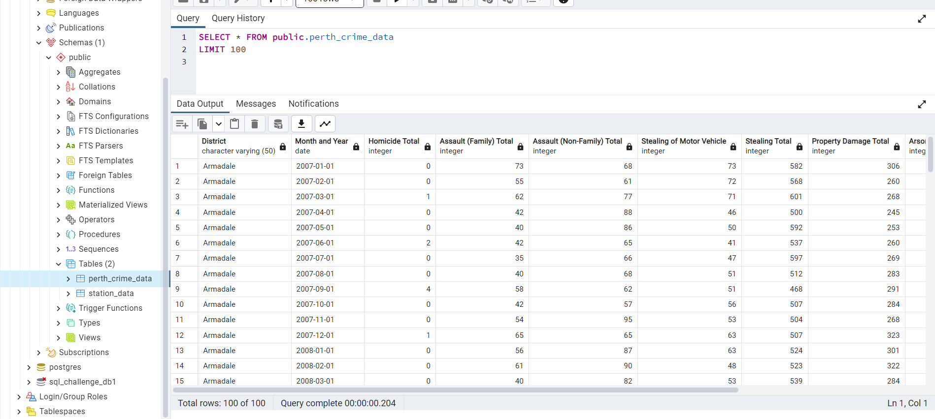
Created tables in a SQL database

Slide 6
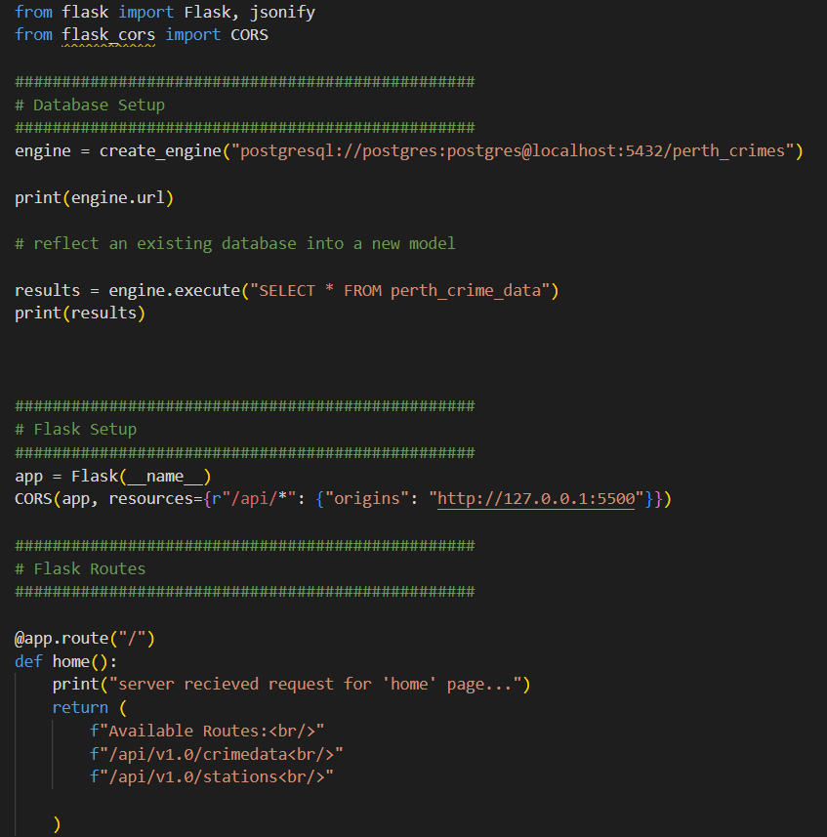
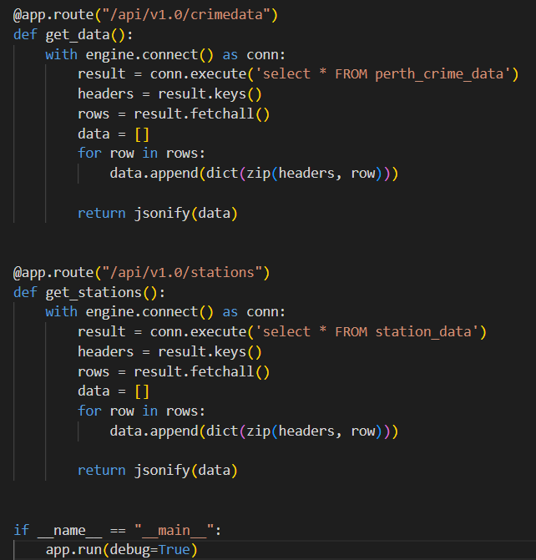
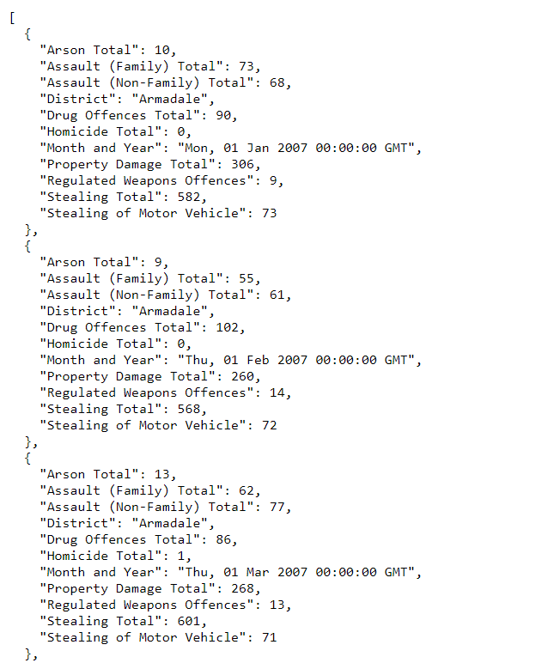
Creating flask api from
the sql databse
Very Very annoying

Slide 7
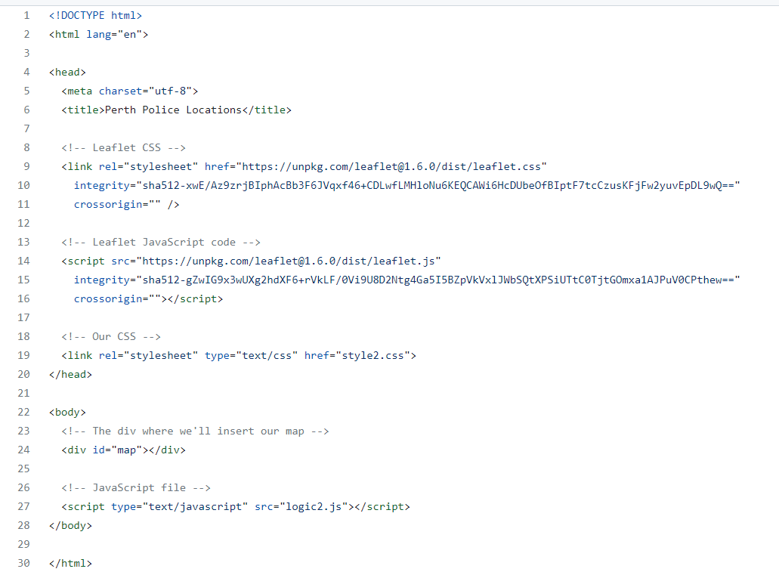
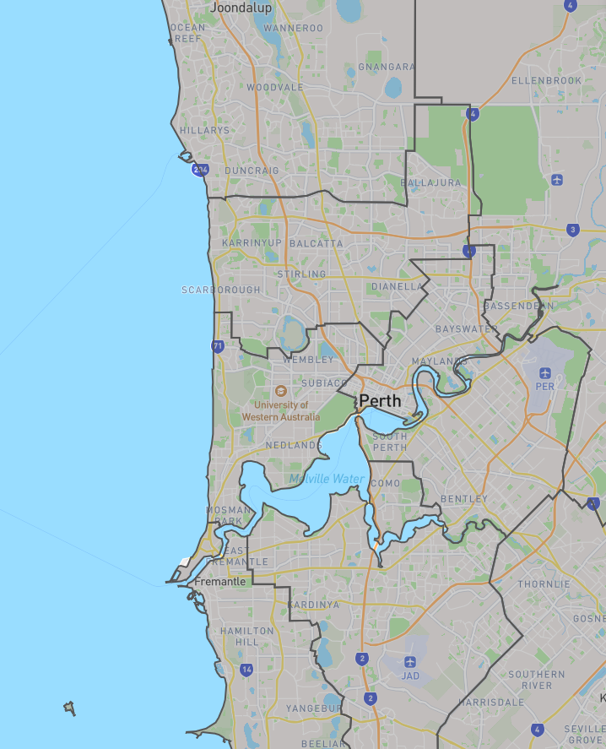
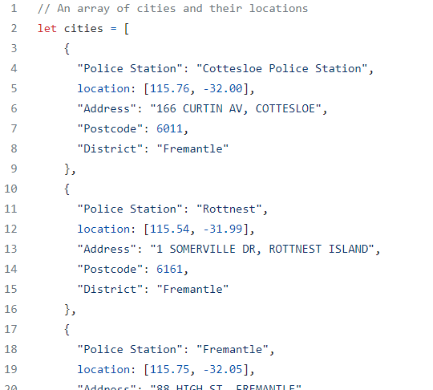
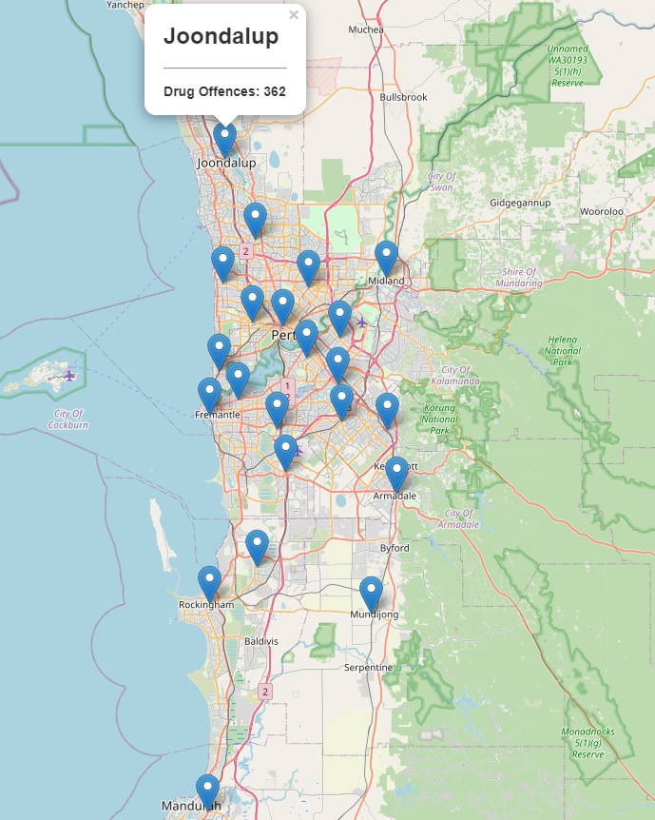
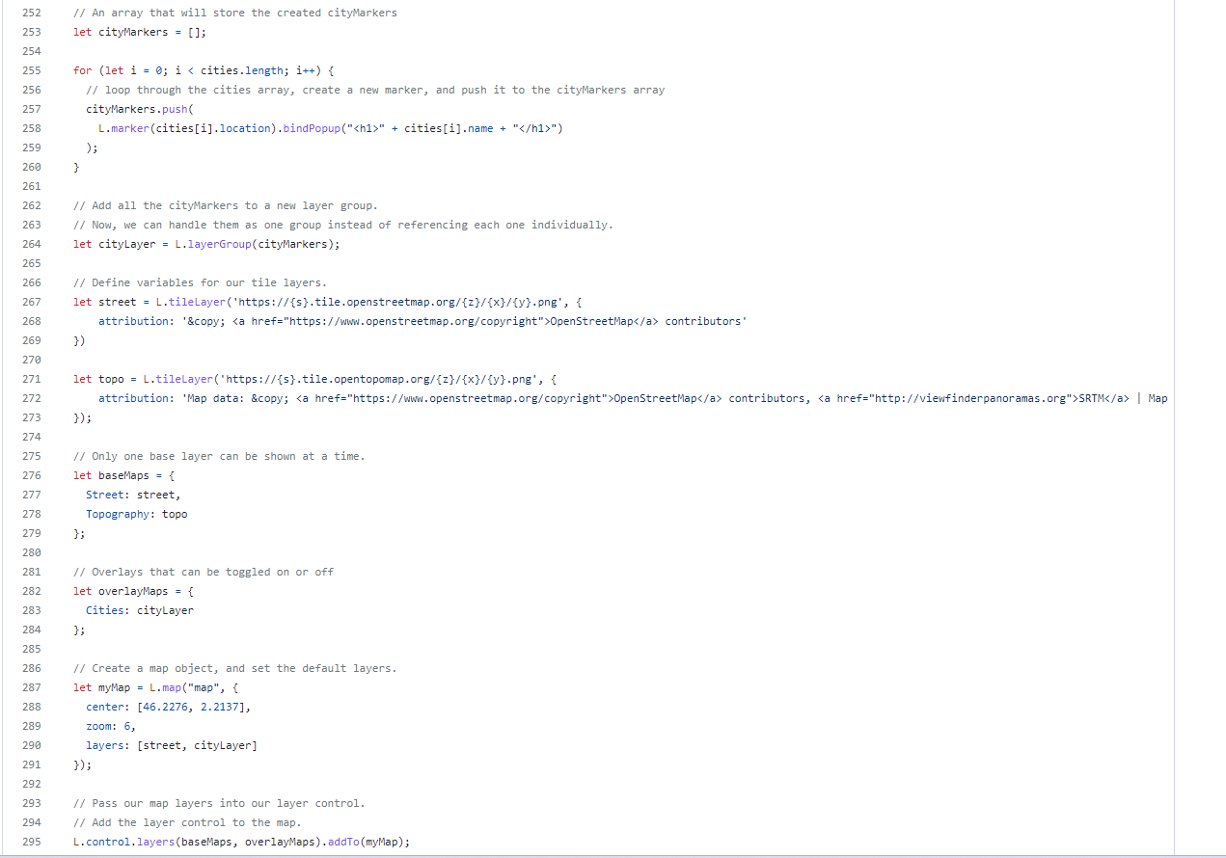
Mapping
Joondalup
Attempted maps
1., Heat map
2. Markers
3. District Map through
Geo.json data
Perth
Fremantle

Slide 8
Mapping
- We used the simpleheat JavaScript Library (https://github.com/mourner/simpleheat) for our heat map. (Which unfortunately has a error).
- Used the activity found in Module 15, lesson 2 as reference, and other google sources for specific errors.
- Similarly for our marker locations we used the same Module as our tools to assist our analysis.
- It was interesting to see the spread of WA’s police stations.
- I failed to be able to obtain an API link, contacted external support with no success.

Slide 9
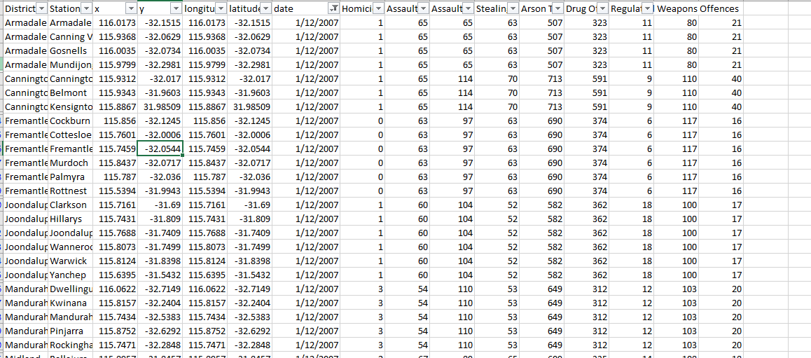
Challenges with mapping
- Data didn’t provide coordinates
- API error, failed to load data
Districts totals did not outline
crimes within suburbs
To solve this we had to
physically record locations
of Police Stations

Slide 10
Findings from our analysis
- Suburbs which we expected to have a lower crime rate due to higher average house prices, was not necessarily proven. Crime was still significant in these areas.
- Peaks in all areas of crime around the 2015 and 2016 time period.
- All areas of crime increase at similar times and at the same rate.
- There has been an increase in stealing, arson, drug and weapon related offences.

Slide 11
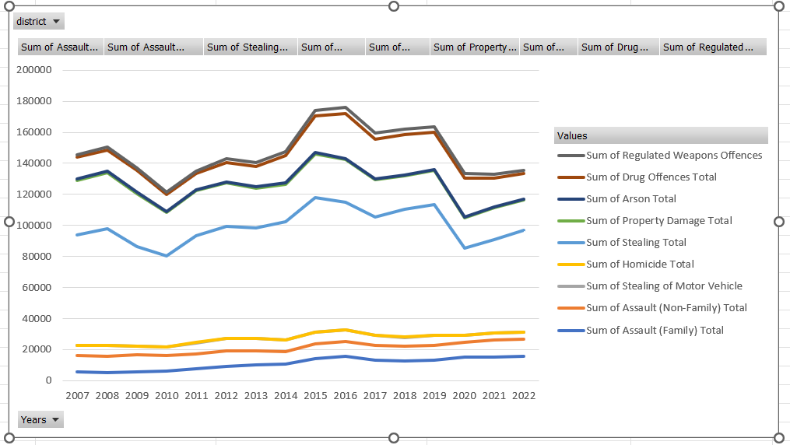
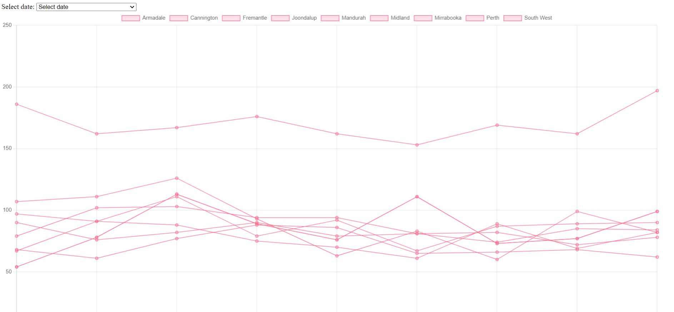
Overall Perth crime trends
expectations
reality

Slide 12
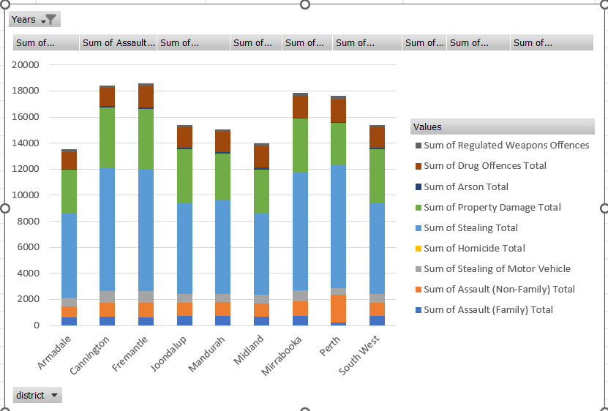
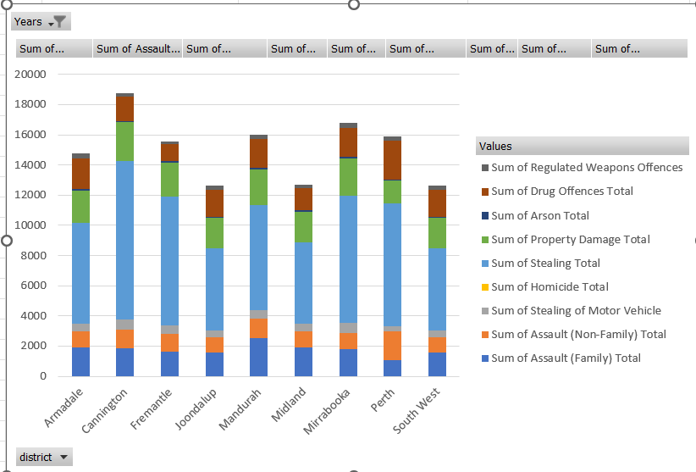
2007 vs 2022 crimes in each district

Slide 13
What we could improve on
- Failed to get the Heat map working, would have been much more satisfied with the project if we could find out how to fix the error. Would of shown a much more comprehensive analysis.
- Thinking into the future. And by that I mean, gathering data that satisfies all our analysis. We encounted issues on our first topic (WA voting results) and quickly moved to our second option. We failed to plan and organise our data efficiently and as a result we struggled with obtaining certain information like Geo.Json files and data that provided information on coordinates.

